Slide 1
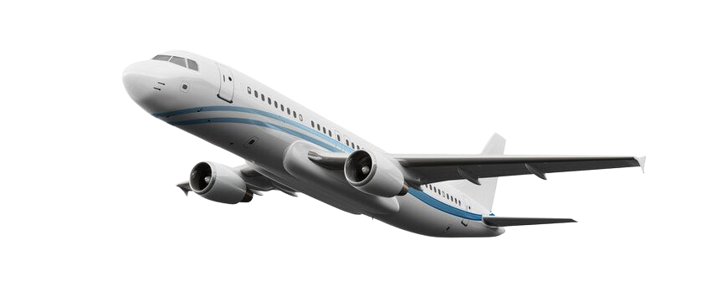
Customer Booking Prediction
British airways

Slide 2

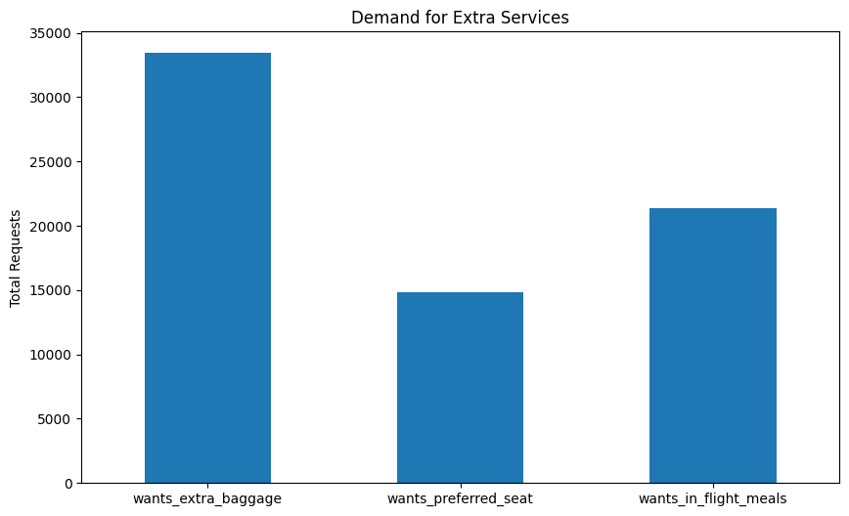
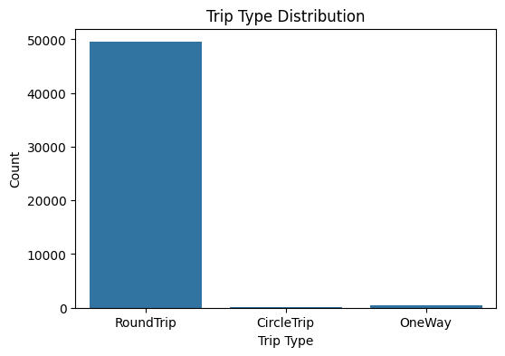
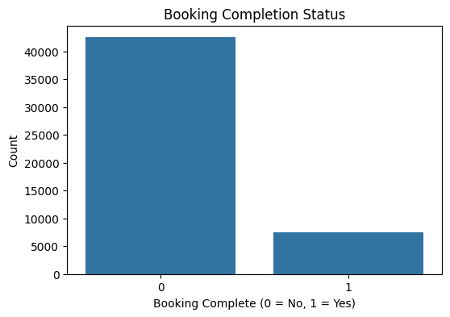
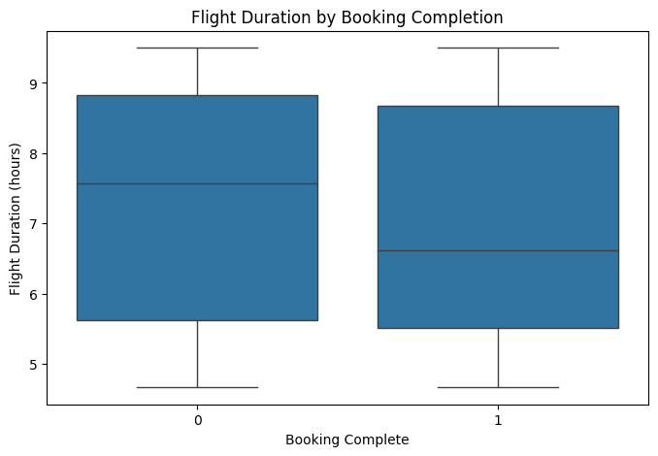
Analyses

Slide 3
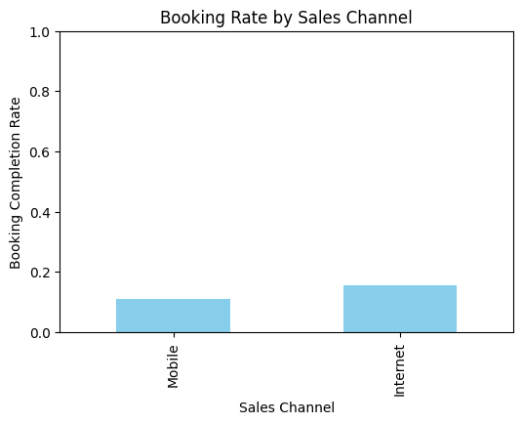
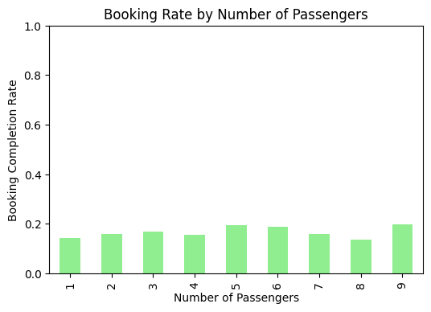

Slide 4
Insights
Passengers who want extra baggage have the highest booking completion rate difference (+5.17%).
Wanting a preferred seat also shows a significant positive impact.
In-flight meals have a smaller but still positive effect on booking completion.

